Slide 1
Dinner Choices Teacher Guide

Slide 2
Contents
What is dinner choices?
How does a teacher use dinner choices?
How to pre-fill dinner choices.
How to enable macros.

Slide 3
What is Dinner Choices?

Slide 4
What is dinner choices?
Allows pupils to choose the meal they desire.
Empowers the pupils to make a choice.
Enables the canteen to produce the correct amount of each meal every day.

Slide 5
How Does a Teacher use dinner choices?

Slide 6
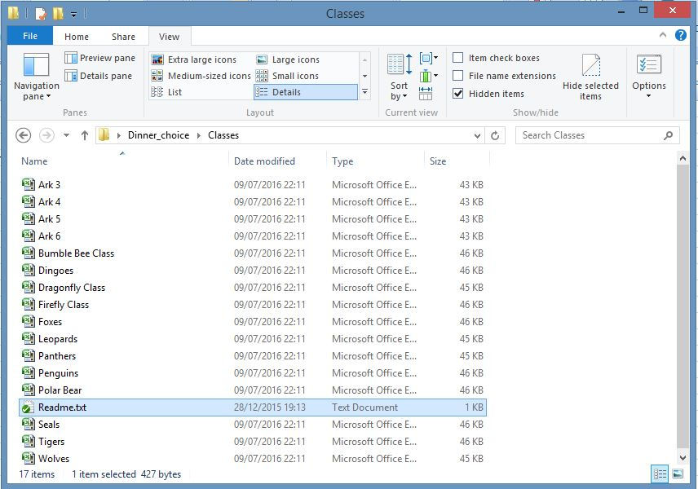
Filling in Dinner Choices (1)
(Make sure Macros are enabled! See last chapter)
Before 9 o’clock the administrator sets the dinner choices for each day and creates individual class spreadsheets.
The class spreadsheets are located in the following directory:
\Dinner_Choice\Classes
At 9 o’clock the directory should look like this, with each class spreadsheet containing the new day’s dinner choice:

Slide 7
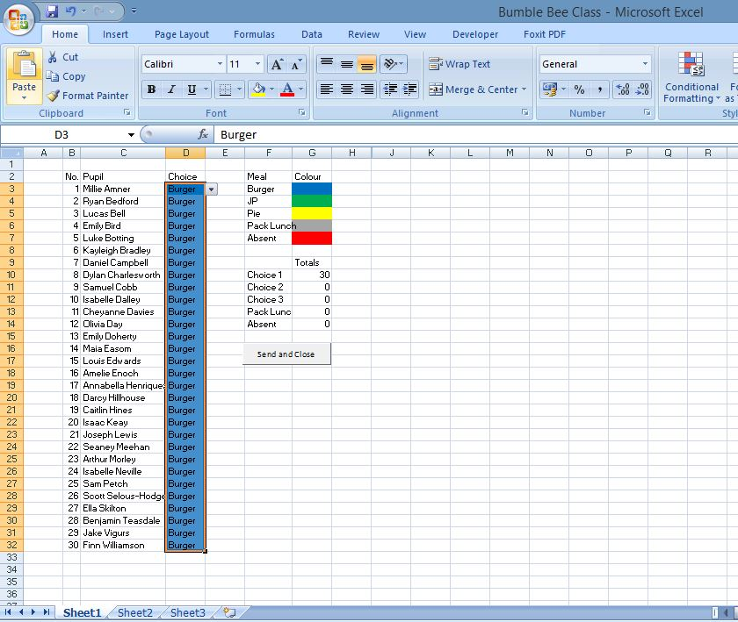
Filling in Dinner Choices (2)
The class teacher needs to get their class to complete the spreadsheet and hand out the corresponding bands by 9:15 so that the administrator and canteen can calculate and cook the requested meals.
The class teacher needs to open their respective class spreadsheet with macros enabled (see Enabling Macros), get the individual pupils to select their meal using the drop downs.
Once all the pupils have selected their choices the “Send and Close” button will become available.
The following is an example completed spreadsheet:
NOTES:
For the “Send and Close” button to become available all the pupils need to have made a choice! This means if a pupil is absent or can’t make a choice then the class teacher has to select the appropriate choice and/or notify the administrator of any changes.
If a mistake has been made the administrator should be notified so that they can adjust the final totals.

Slide 8
Possible errors

Slide 9
Possible errors
Question - The send and close button is not available.
Answer -
- Check macros are enabled
- Check all the pupil dropdowns are complete
- Report it immediately to the administrator
Question – A pupil is late into school
Answer –
Question – A pupil doesn’t know which choice they’ve made
Answer –
The administrator can find out the individual pupils choices
Question – I get an excel error runtime message
Answer –
- Are two copies of the spreadsheet open?
- Please note down the error message (including number) and send to the administrator.

Slide 10
Finally

Slide 11
Finally
Please pass on any feedback to the administrator. Dinner choices is there to help the teachers/canteen and should be something the pupils enjoy completing.

Slide 12
Pre-filling dinner choices

Slide 13
Pre-filling dinner choices
If a pupil is long-term absent or continuously makes the same choice (such as continuous packed lunch or continuous vegetarian lunch), then a pupil might get bored and/or it might be more efficient to pre-fill the data with the same information set daily.
In order to do this please contact the administrator who can set the desired option.
Notes:
Using this method it’s possible to colour code pupils based on their dietary requirements.
It’s still possible to modify pre-filled data although not ideal to save time.

Slide 14
Enabling macros

Slide 15
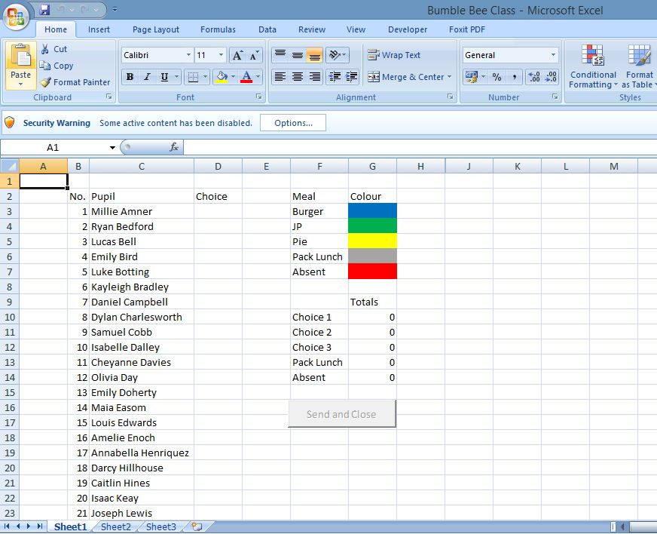
Initial warning without macros enabled
Without macros the buttons and functionality won’t be enabled

Slide 16
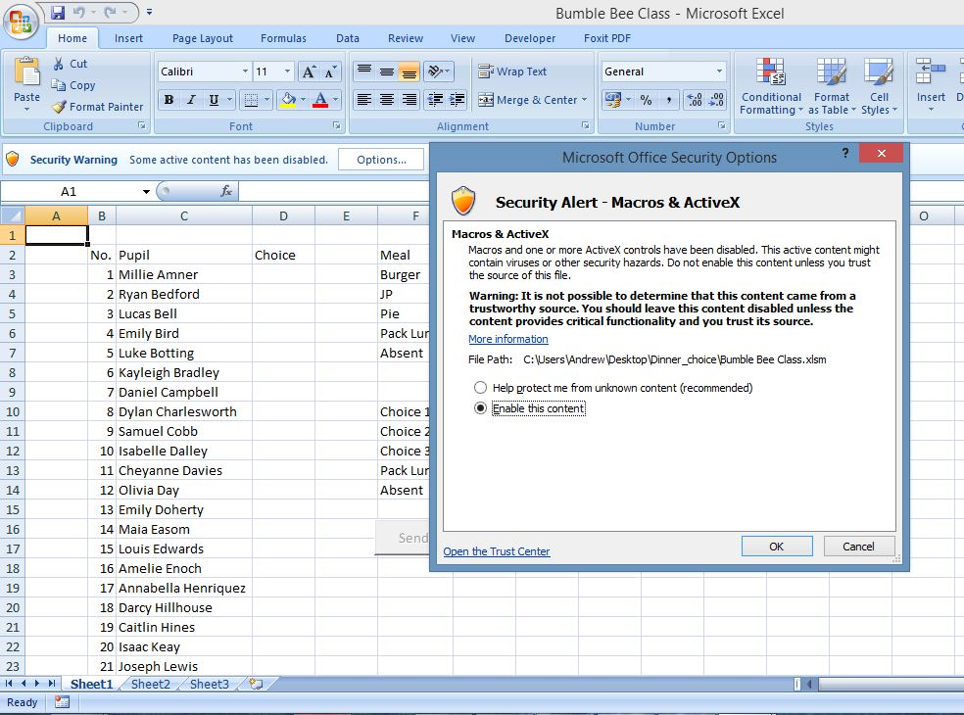
Simple enabling (not the best way)
Click on “Enable this content” and ok

Slide 17
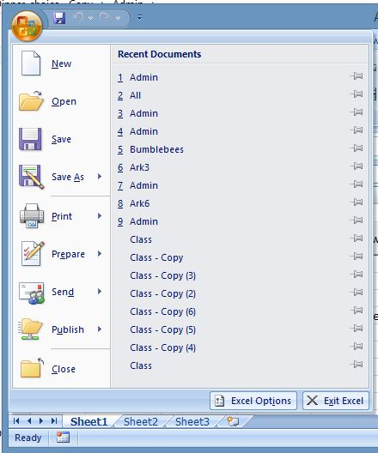
Long term you should trust the location by following these steps
Firstly click on the office button
Then open “Excel Options”

Slide 18
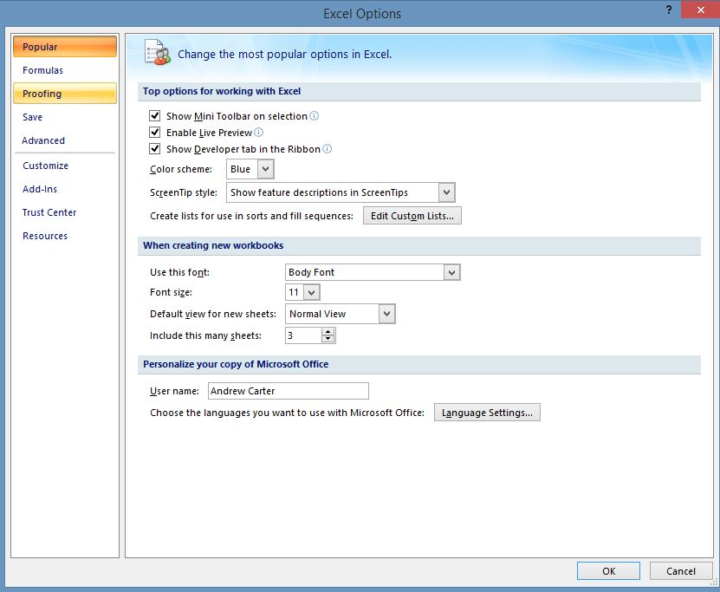
Goto Trust Center

Slide 19
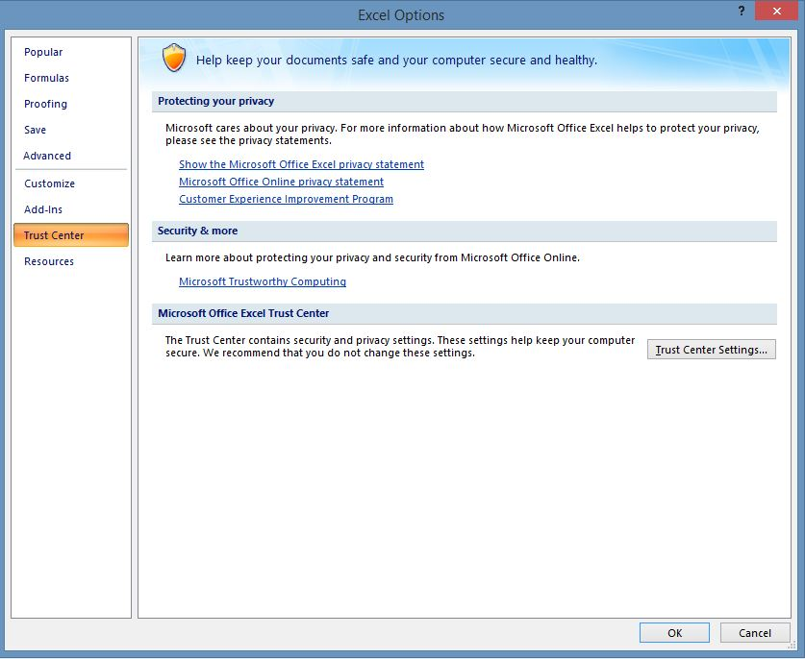
Should get you here

Slide 20
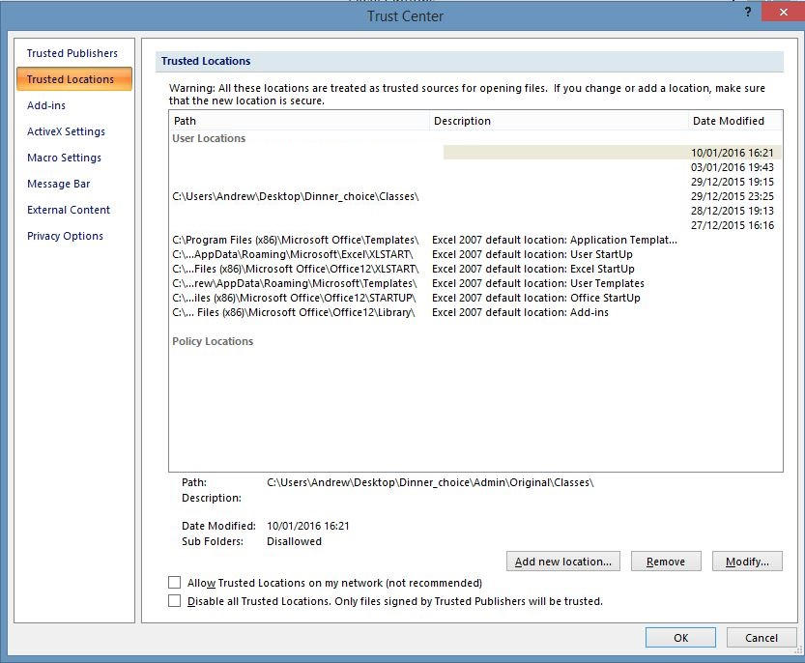
Add new location
For teachers this should be the directory:
Dinner_choices\classes

